Slide 1
App lifecycle
Developer's guide to
Windows 10 Insider Preview
Andy & Jerry

Slide 2
Application lifecycle
Suspension in Template 10
Extended execution

Slide 3
Application lifecycle

Slide 4
App Lifecycle
Background task executes
Running
app
Suspended
app
Terminated
app
Suspending
Low memory
Resuming
Notes:
Note: They are not supposed to communicate with each other but it is possible either by Progress/Completed/Canceled events or… by file
Green boxes code runs in parallel to the App or while suspended/terminated
Read http://blogs.msdn.com/b/windowsappdev/archive/2012/05/24/being-productive-in-the-background-background-tasks.aspx for more details

Slide 5
Predictable behavior on every Windows device

Slide 6
Application Lifetime
Running
Suspended
Running
Suspended
Not Running
Memory
Launched
Suspended (5 seconds)
Activated
Suspended (5 seconds)
Terminated (no event)

Slide 7
Desktop-family apps suspend when they are minimized

Slide 8
Handling suspension
public App()
{
this.InitializeComponent();
this.Suspending += (s, e) =>
{
// Save data
};
this.Resuming += (s, e) =>
{
// Load data
};
}

Slide 9
Suspension in Template 10

Slide 10
Handle suspend

Slide 11
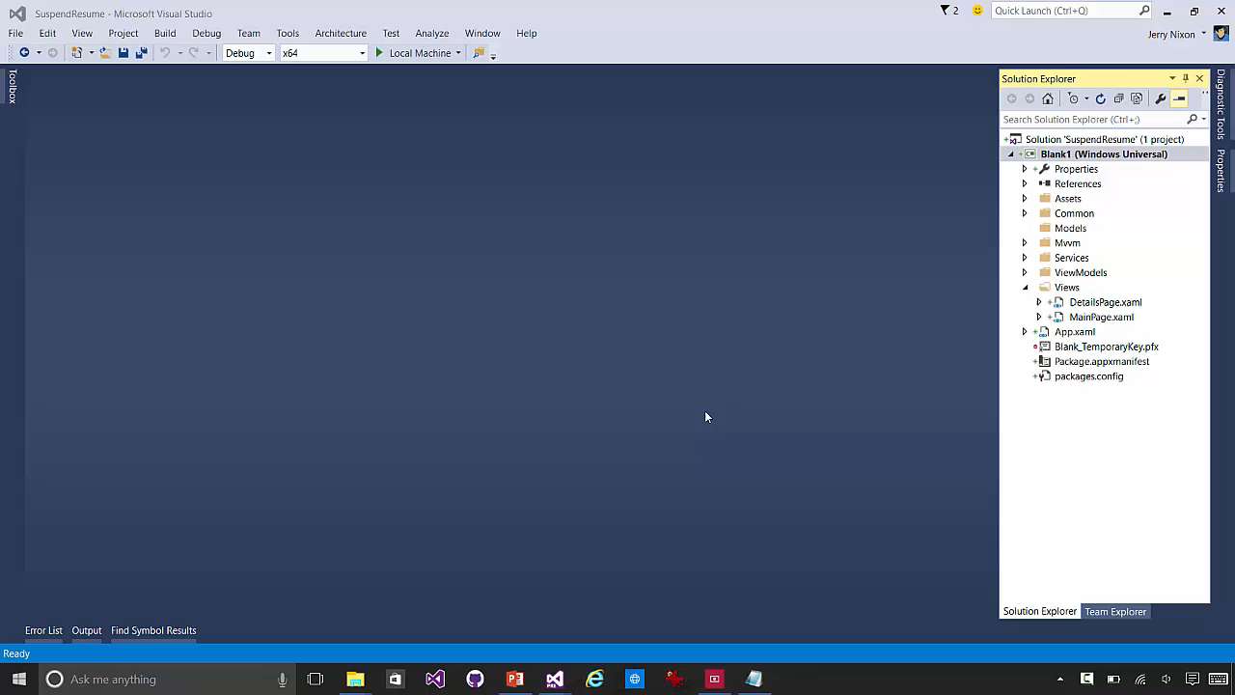

Slide 12
OnNavigatedFrom
public override Task OnNavigatedFromAsync(IDictionary<string, object> state, bool suspending)
{
if (suspending)
{
state["FirstName"] = this.FirstName;
state["LastName"] = this.LastName;
state["Email"] = this.Email;
}
return Task.FromResult<object>(null);
}

Slide 13
OnNavigatedTo
public override void OnNavigatedTo(string parameter, NavigationMode mode,
IDictionary<string, object> state)
{
try
{
this.FirstName = state["FirstName"].ToString();
this.LastName = state["LastName"].ToString();
this.Email = state["Email"].ToString();
}
finally { state.Clear(); }
}

Slide 14
Extended execution

Slide 15
Extended execution
Requesting extended execution
There is no guarantee resources are available Extended execution has no UI
Scenario “I have data this time”
Handle the Revoked event (1 second warning)
Scenario “I’m a special kind of app”
These apps run indefinitely
Special kinds of apps
Turn-by-turn (location tracking) app
Audio & VOIP application

Slide 16
There is a balance between load speed & shutdown time

Slide 17
Extended execution (type 1)
Running
Extend
Suspended
Request
Revoked (1 second)
Memory
No UI
(short)
When
suspending
Suspended (5 seconds)
Suspended
(No event)

Slide 18
Requesting extension in suspend
private async void OnSuspending(object sender, SuspendingEventArgs args) { var deferral = e.SuspendingOperation.GetDeferral(); using (var session = new ExtendedExecutionSession{ Reason = ExtendedExecutionReason.SavingData }) { session.Description = "Upload Data";
session.Revoked += (s, e) => { Log("Save incomplete"); }; try { if (await session.RequestExtensionAsync() == ExtendedExecutionResult.Denied) // takes 3 seconds
UploadBasicData(); else // takes 8 seconds
await UploadDataAsync(session); Log("Save complete"); } catch { Log("Save failed"); } finally { deferral.Complete(); } } }

Slide 19
Extend the suspension of a foreground app

Slide 20
Extended execution (type 2)
Running
Extend
Suspended
Automatic extension
Revoked (1 second)
Memory
No UI
(long running)
When
running
Special Request (during runtime)
Navigate away
Suspended
(No event)

Slide 21
Prevent the termination of a foreground app

Slide 22
Requesting extension in app
private async void InvokeMyExtension() {
if (this._session == null) {
this._session = new ExtendedExecutionSession{ Reason = ExtendedExecutionReason.LocationTracking } this._session.Description = “Driving directions";
if (await this._ session.RequestExtensionAsync() == ExtendedExecutionResult.Allowed) {
// todo approved
}
else {
// todo denied } } }

Slide 23
Enum VALUES
[ContractVersion(typeof(UniversalApiContract), 65536)]
public enum ExtendedExecutionReason
{
Unspecified = 0,
LocationTracking = 1,
SavingData = 2
}
[ContractVersion(typeof(UniversalApiContract), 65536)]
public enum ExtendedExecutionResult
{
Allowed = 0,
Denied = 1
}

Slide 24
The global pool supports burst events

Slide 25
Application lifecycle
Suspension in Template 10
Extended execution

